Slide 1

Financial Risk Management
Spring 2016
Dr. Ehud Peleg
Market VaR I

Slide 2
Modeling Market VaR
Parametric Models
Delta-Gamma
Monte Carlo Simulation
Non-Parametric Simulation
Historical VaR
Semi-parametric: time and volatility weighting
Simulations: Allocation and Confidence Intervals
We look at 1-day VaR, unless stated otherwise

Slide 3
Model-Building / Parametric Approach

Slide 4
Model-based or Parametric VaR
Select a set of market variables or factors that underlie the prices and values of the portfolio
E.g. stock indices, interest rates, principal components
Assume returns of factors follow certain stochastic processes, i.e. changes in their value in the next day have certain probability distributions
E.g. daily stock returns are Normal
Estimate parameters for the underlying processes
E.g. use GARCH(1,1) to estimate exchange rate volatility
Figure out the distribution of daily changes of the portfolio based on the distribution of underlying factors
Closed-form or by simulation
Find the appropriate percentile of the distribution

Slide 5
Linear-Normal Model Assumptions
Daily change in the value of a portfolio is linearly related to the daily returns of market variables or factors
Returns on factors are normally distributed, with mean zero, and a covariance matrix
Each factor return, i, has variance σ_{i}
Every 2 factor returns, i and j, have covariance cov_{ij}
Under these assumptions, returns on the portfolio are also Normal with mean zero.
To find VaR, we need only find the portfolio Variance

Slide 6
Linear Model / Delta Method
Define returns on market variables:
And deltas of the portfolio with respect to asset i:
Then changes in portfolio value are approximated by:

Slide 7
Variance of Portfolio Value

Slide 8
How should we apply this method to:
Portfolio of Options
Portfolio of Bonds

Slide 9
Delta Method – Example w/options
Consider an investment in options on Microsoft and AT&T. Suppose the stock prices are $120 and $30 respectively and the deltas of the portfolio with respect to the two stock prices are 1 and 20 respectively.
Approximate the change in portfolio value as function of Δx₁ and Δx₂, the returns on the two stocks:

Slide 10
Delta Method Example - Cont
Assume daily return volatility for Microsoft is 2% and that of AT&T is 1%, correlation between the two is 0.3, what is the 5-day 95% VaR?
The variance of the portfolio is:
σ_{P}² = (120*0.02)² + (600*0.01)² + 2*120*0.02*600*0.01*0.3 = 50.40
The five-day 95% VaR is

Slide 11
Delta – Gamma
The linear model will not be accurate because option prices are linear only for small changes in the underlying.
We can improve our estimation by using gamma as well:

Slide 12
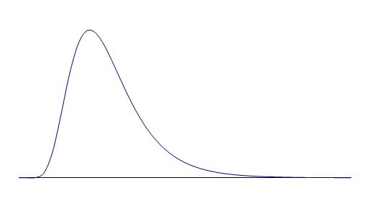
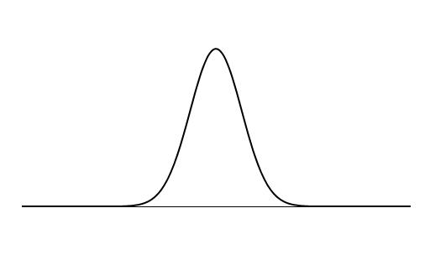
Translation of Asset Price Changes to Price Changes for Long Call
Long Call
Skewed distribution for option
Asset Price
Normal distribution for underlying asset

Slide 13
Translation of Asset Price Change to Price Change for Short Call
Asset Price
Short Call

Slide 14
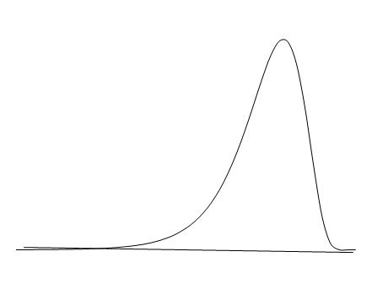
Impact of Gamma
Positive Gamma
Negative Gamma

Slide 15
Quadratic / Delta-Gamma Model
For a portfolio dependent on a single asset price it is approximately true that
so that
Recall , hence:

Slide 16
Quadratic Model
When there are a small number of underlying market variable moments can be calculated analytically from the delta/gamma approximation
The Cornish – Fisher expansion can then be used to convert moments to quantiles

Slide 17

Quadratic Model – Estimating Quantiles
Use Moments to find skewness:
Cornish – Fisher: The q percentile is
where
Z_{q} is the relevant quantile of the standard normal.
For example, if we’re looking for VaR_{95%} then it will be N⁻¹(0.05)=-1.645.

Slide 18
Delta-Gamma Example
The current value of a stock index is $1,500, and its daily volatility is 2%
A portfolio of options on the index has delta=0.5, gamma=0
Use the delta-gamma method to estimate the mean, variance and skewness of dollar returns of the portfolio.
What is 1-day VaR-95%?

Slide 19
Delta-Gamma Example
Mean=0
Variance=δ²S²σ²=(0.5)²*1500²*(0.02)²=225
Skewness=0
The 5%-ile is:
VaR-95%=|-25|=25

Slide 20
Effect of Gamma on Portfolio and VaR
What if Portfolio Gamma = 0.07? Gamma = -0.07?
Gamma | 0.07 | 0 | -0.07
E(ΔP) | 31.5 | 0 | -31.5
var(ΔP) | 2,210 | 225 | 2,210
skewness | 2.817 | 0.000 | -2.817
w_{q} | -0.844 | -1.645 | -2.446
5%-ile | -8 | -25 | -146

Slide 21
Modeling Bonds in Linear Model
Duration Approach: Linear relation between ΔP and Δy (allows parallel shifts only)
Zero Coupon Bonds: Underlying variables are zero-coupon bond returns with many different maturities
Principal Components Approach: 2 or 3 independent shifts with their own volatilities, capture most of the variance in term-structure moves

Slide 22
Duration Approach
Recall
Therefore:
Assume yield follows:
Then the price will follow:
s.t.

Slide 23
Duration Approach
Suppose that the volatility of daily changes in interest rates is 0.1% with mean=0
Our Portfolio is worth $820 and has duration of 5
Using the normal-linear approach find the 1-day VaR_{95%}:
The dollar duration is 820*5=4,100
Portfolio value will drop by $41 for 1% rise in yield.
VaR_{95%} = 4100*[0+1.645*0.001] = $6.74

Slide 24
Duration Approach Caveats
The duration approximation is for small changes in yield, VaR might involve large changes, where the approximation fails
Include convexity and use delta-gamma.
The portfolio might be affected by non-parallel shifts in the yield curve.

Slide 25
Zero-coupon Bond Returns as Underlying Variables
We can choose as market variables zero-coupon bond price changes with standard maturities (for example: 1m, 3m, 6m, 1yr, 2yr, 5yr, 7yr, 10yr, 30yr)
We need to estimate the covariance matrix of all these bond price returns.
We need to map the portfolio to each of the maturities.
Suppose we have n maturities:

Slide 26
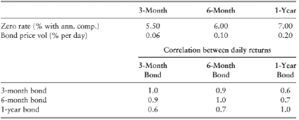
Bond Portfolio Example
Consider a portfolio invested $37,397 in 3mm, $331,382 in 6mm and $678,074 in 1-yr bonds
Rates, vols and correlations for bond prices:

Slide 27
Example – cont.
Portfolio Variance =
37,397²*(0.06%)²+331,382²*(0.10%)²+
678,074²*(0.20%)²+2*37,397*331,382*(0.06%)*(0.10%)*0.9+2*331,382*678,074*(0.10%)*(0.20%)*0.7+2*37,397*678,074*(0.06%)*(0.20%)*0.6 = 2,628,518 = 1,621.3²
10-day VaR-99% = 1621.3*2.33*sqrt(10)=$11,946

Slide 28
Zero-Coupon Bond Return Disadvantages
Requires many underlying variables
We need to map bond cash flows that arrive at times different than our underlying bonds.

Slide 29

Using PCA to Calculate VaR
We can use 2 or 3 PCAs as underlying factors.
It requires:
Portfolio sensitivities to those factors
Volatilities of the factors
We estimate less deltas and don’t need covariance matrix as PCs are orthogonal

Slide 30
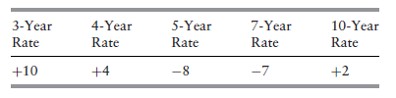
PCA Example
Suppose a portfolio has the following sensitivities to 1-basis-point rate moves, in $ millions:
What are the portfolio sensitivities to PC1 and PC2?
PC1:
PC2:

Slide 31
PCA Example – Cont.
We get:
where f₁ is the first factor and f₂ is the second factor
If the SD of the factor scores are 17.55 and 4.77 the SD of ΔP is

Slide 32
Thanks

